Slide 1
NF.5
Learning Target
I can write a fraction with a denominator of 10 as an equivalent fraction with a denominator of 100.
4th Grade Lesson
By: Sandra Martinez and Valerie Hepburn

Slide 2
Fraction
Denominator
Equivalent
Numerator

Slide 3
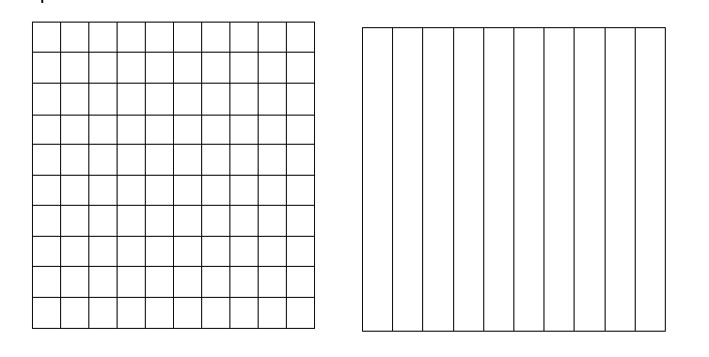
Purpose:
Today we are going to learn how to generate equivalent fractions, one with a denominator of 10 and the other with a denominator of 100 using a grid model.

Slide 4
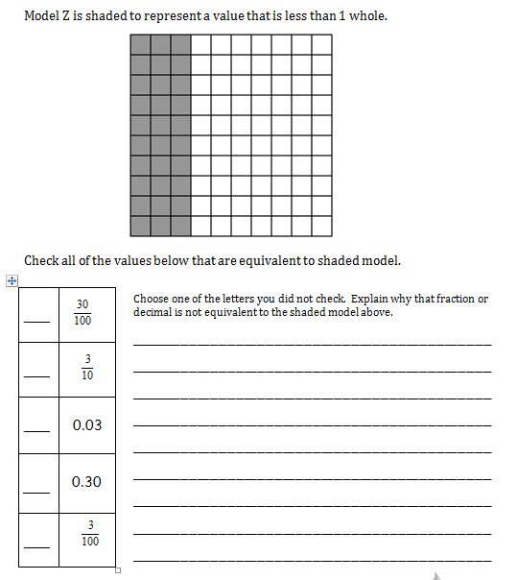
Turn and talk to a partner to check the values that are equivalent to the shaded grid model.

Slide 5
Students: You will work in collaborative groups of three in order to match cards with equivalent values. You must discuss the placement of your cards with your partner and justify your reason for the placement of the cards.
Once the matches are made, you can glue them down on a poster.
Please use the sentence frame below to justify your reasoning:
____ is equivalent to ____ because…
10 100

Slide 6
Exit Ticket
Shade in the grid models to make the fractions equivalent

